Slide 1
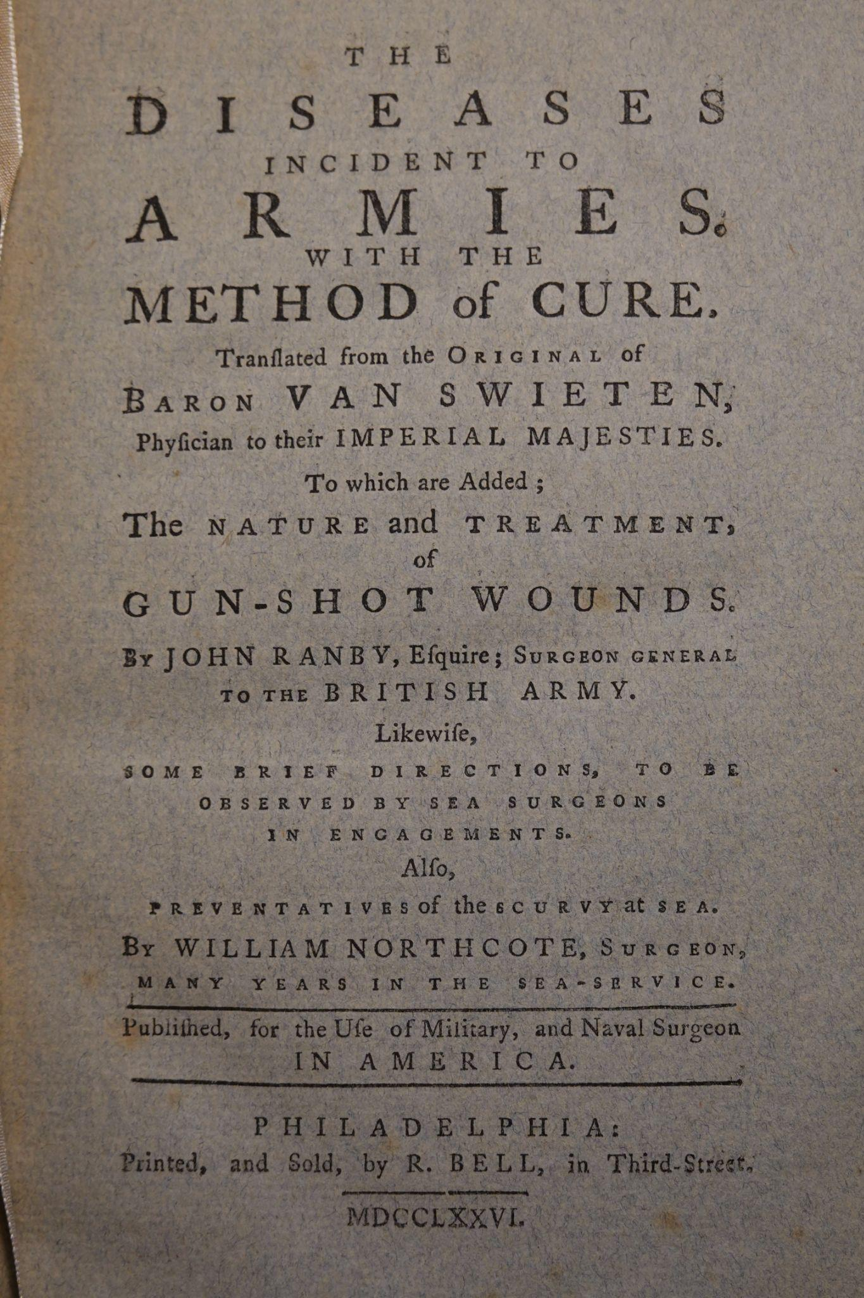
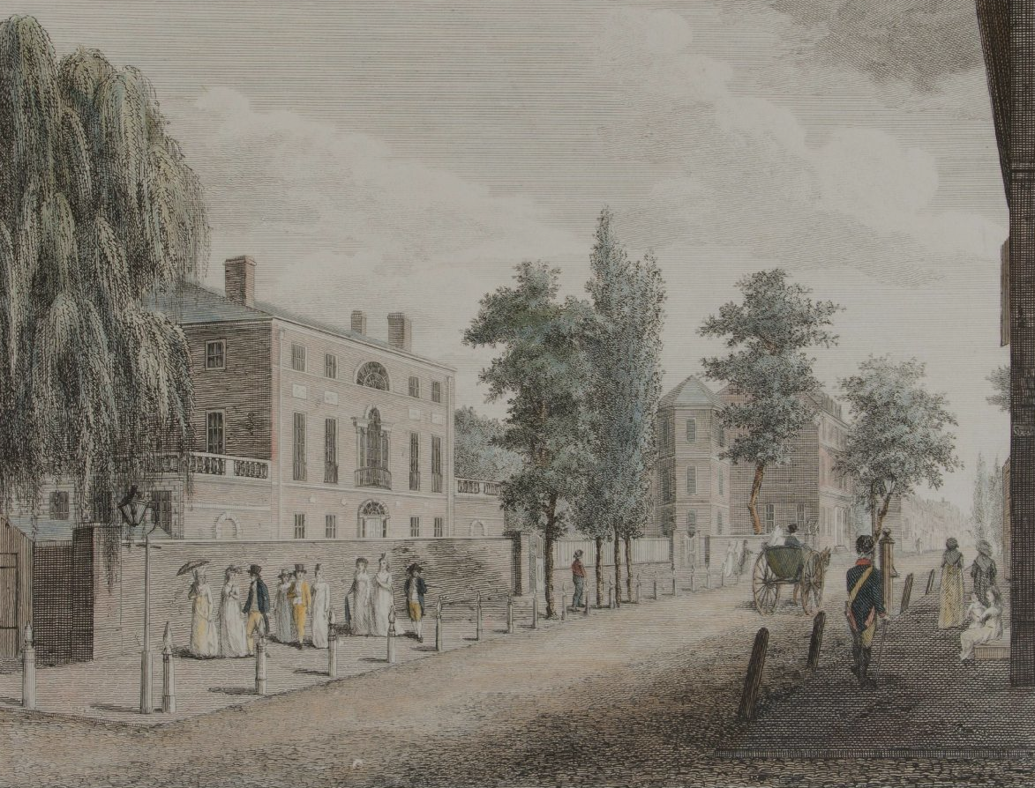
Publishing, Paper, and the American Enlightenment
Robert Bell’s 1776 edition of The Diseases Incident to Armies
Notes:
Today I’m going to be talking about The Disesases Incident to Armies, bound with three other small texts on military medicine, originally authored by Gerard van Swieten and printed by Robert Bell in Philadelphia in 1776. The book tells a story that routs the European enlightenment and the advent of scientific medicine through the distinctly American enlightenment and its first major announcement of itself - the revolutionary war.
*this is not an endorsement of enlightenment philosophy, but that’s a whole other and longer presentation

Slide 2
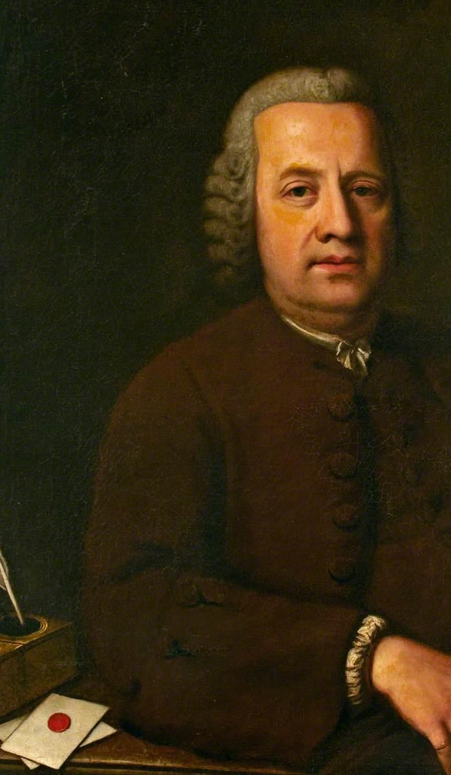

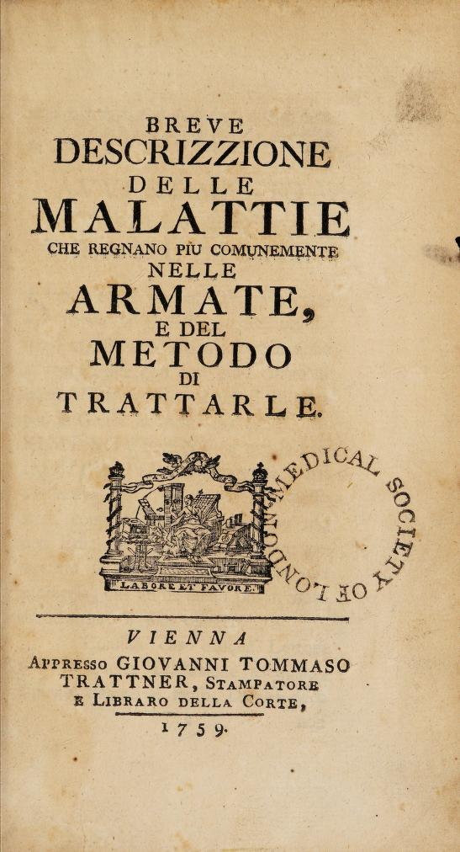
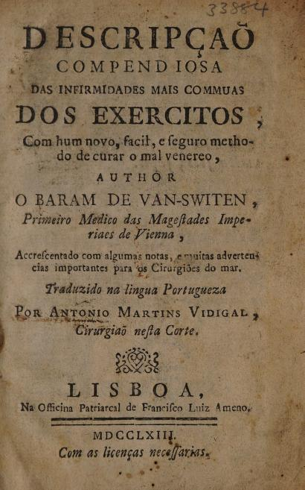
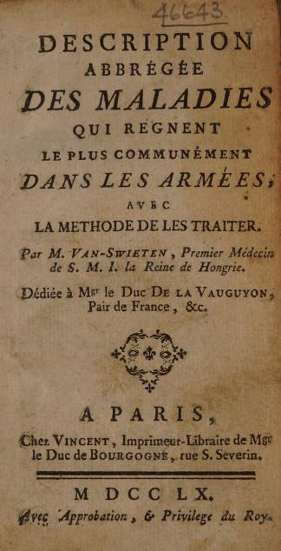
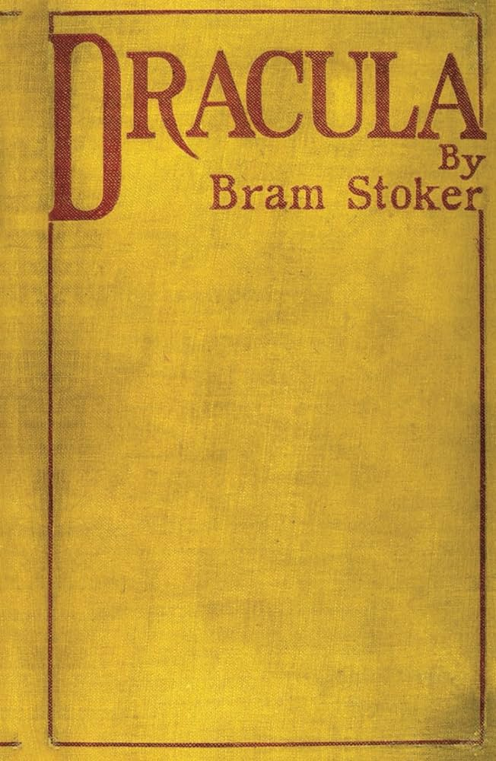
Briefly:The Text and Its Author
Notes:
First, a bit about the original and main text of this book and its author. Baron Gerard van Swieten was a Dutch scientist and doctor, pioneer of the scientific method in European medicine, personal physician to the empress Maria Theresa of Austria, and author of several widely translated medical texts including Diseases incident to armies, a medical text on common diseases seen in military camps and instructions for their treatment, pictured here in German, Italian, and Portugese. He was also the inspiration for the character of Van Helsing in Bram Stoker’s Dracula. (He was sent to slovenia to investigate rampant reports of vampirism and debunked them in a long essay).

Slide 3
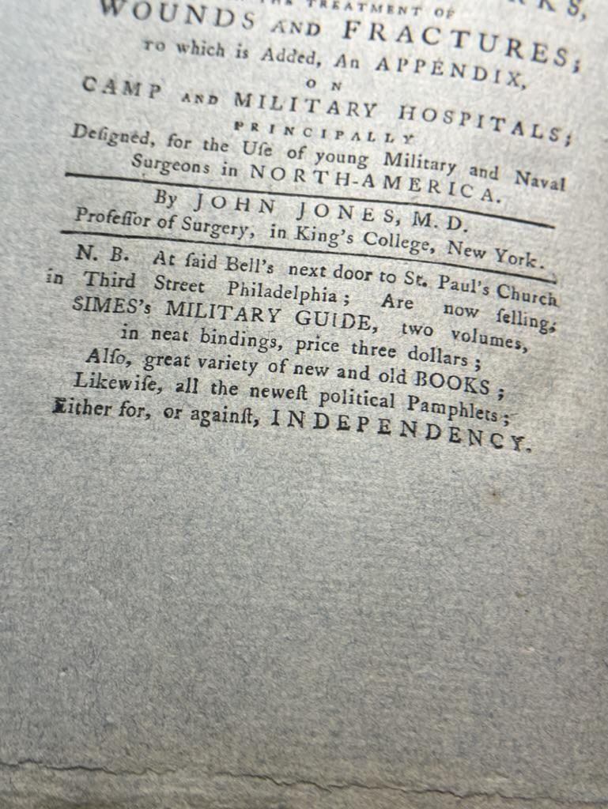
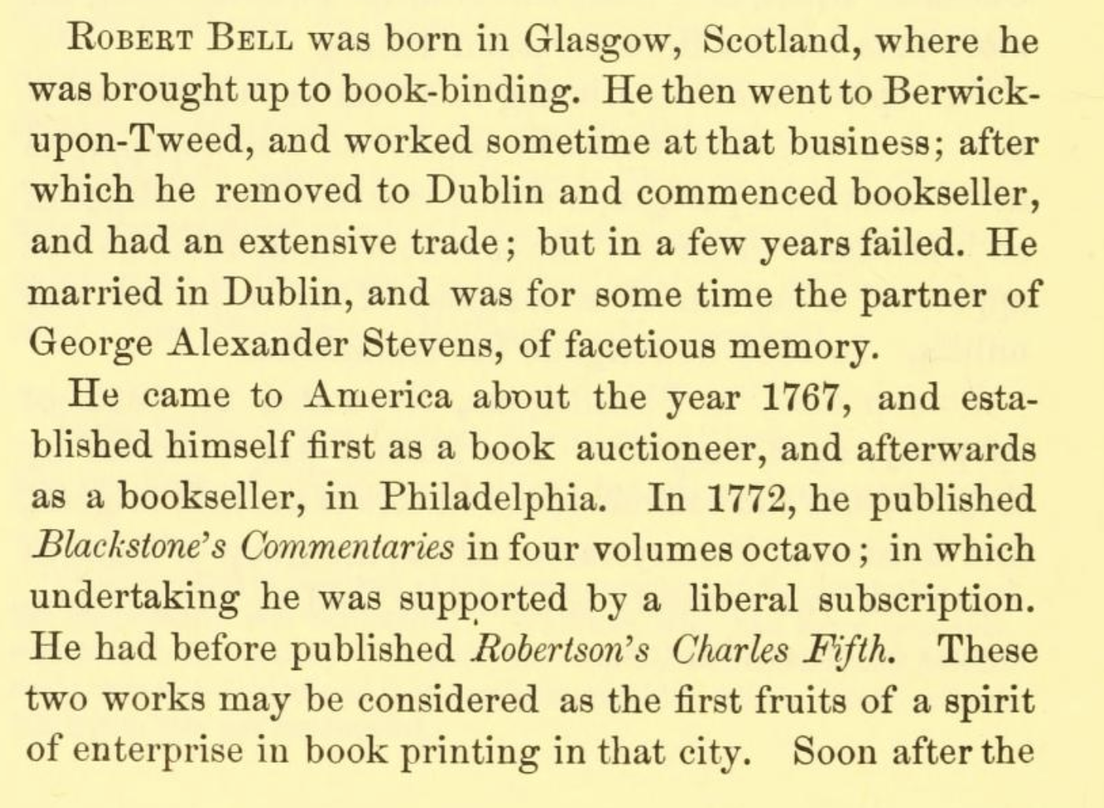
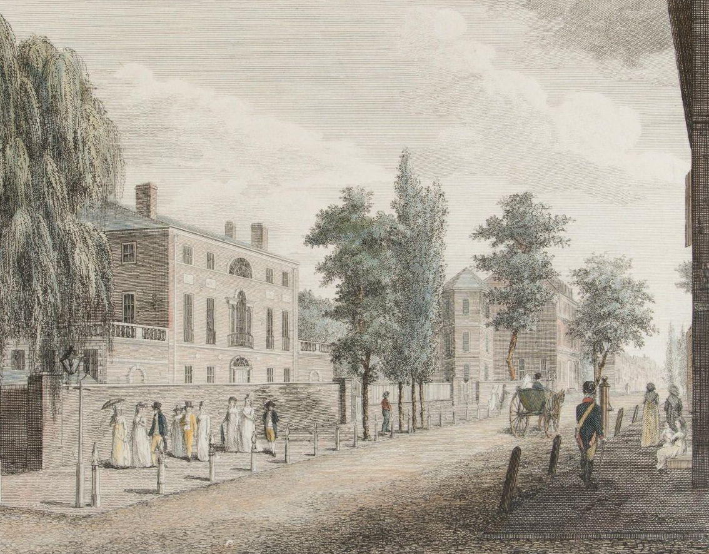
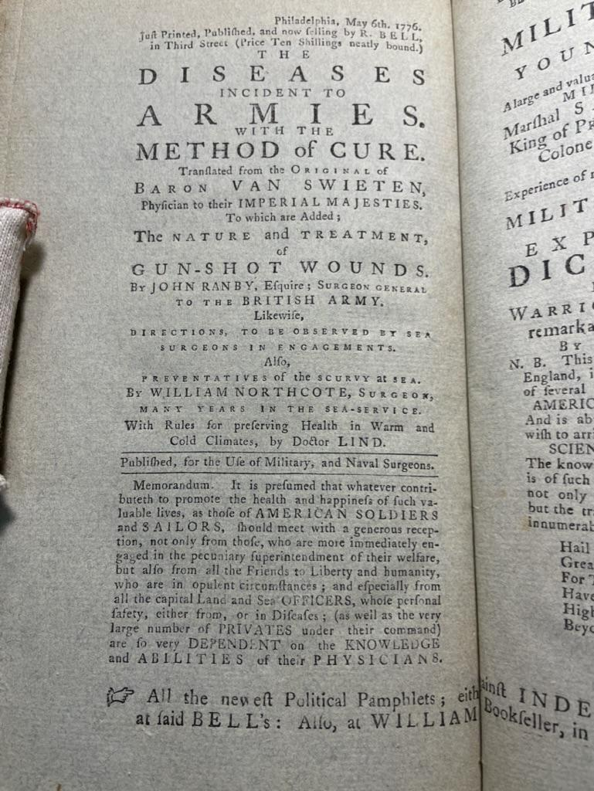
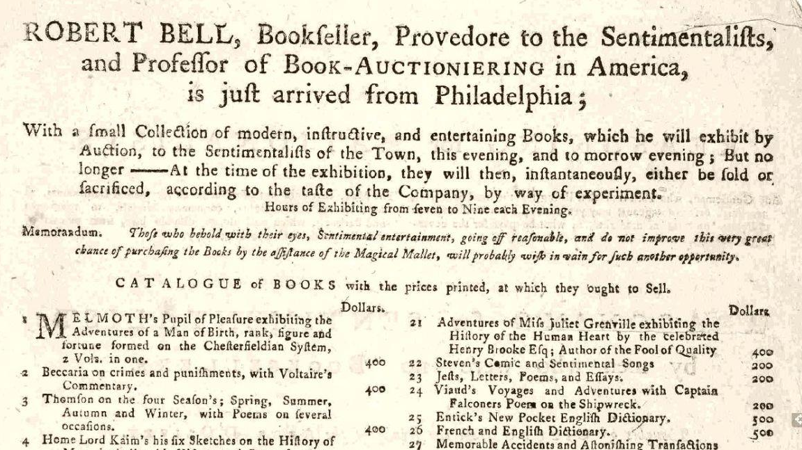
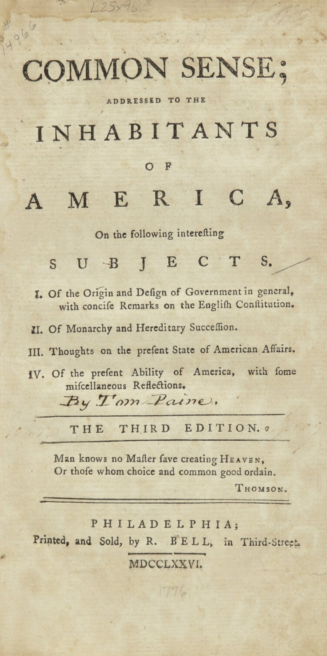
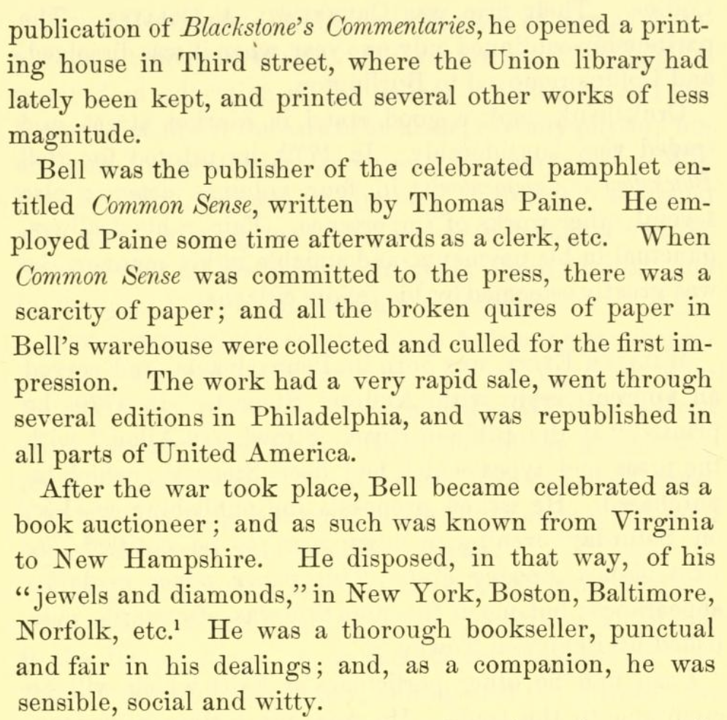
Robert Bell:
Printer, Publisher, Bookseller, Wheeler/Dealer
Notes:
Now on to the printer of this text: Robert Bell. Bell was a Scottish-born immigrant to the states who began his career in bookbinding and bookselling, starting his press once he moved to philadelphia a few years before the start of the revolutionary war. In 1776, the same year Diseases was published, Bell published Thomas Paine’s Common Sense, a critical text of the revolutionary period and to this day one of the bestselling titles in the history of US American publishing. Philadelphia was one of the epicenters of the action in in the revolutionary war and in 1776 was actively host to both the domestic colonial army and the occupying british. Bell managed to position his business so as to profit from many aspects of the war, from the medical needs of the nascent colonial army to the political needs of people on both sides of the issue of independence, as illustrated here in these advertisements for Bell’s shop bound in my book. A classic example of the mercantile spirit which played such a large role in the Enlightenment and america’s revolution in particular (it was a bourgeois revolution, after all), Bell ended his life and career as a traveling bookseller who specialized in rare books for elite urban clientele as well as broad material for the masses who he encountered in his travels around the country.
side panel bio from Isaiah Thomas’s The history of printing in America, with a biography of printers, 1874 (src: https://archive.org/details/historyofprintin01thom/mode/2up)

Slide 4
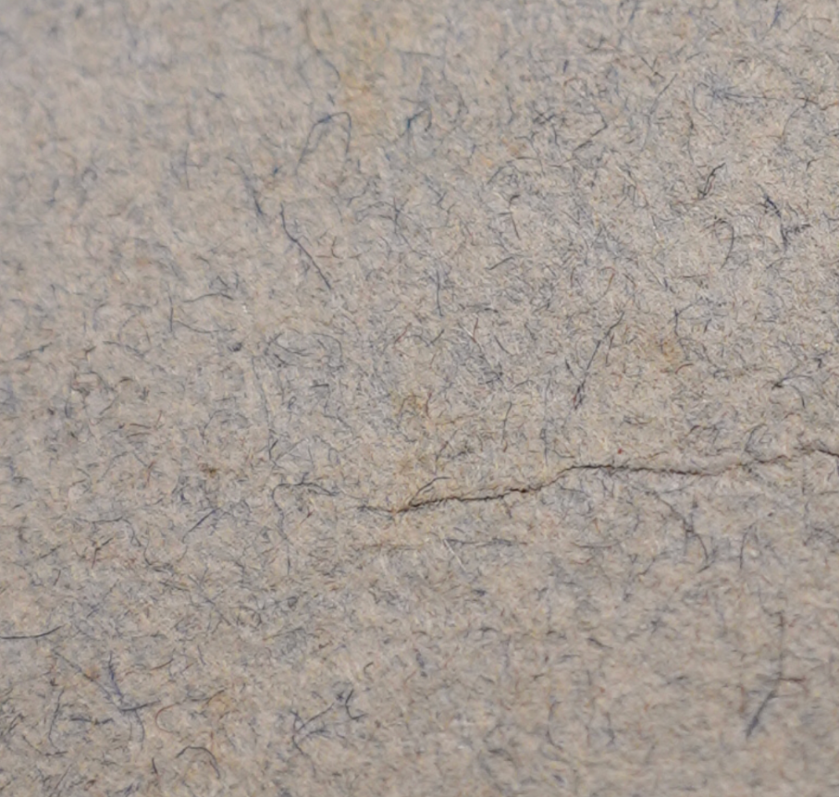
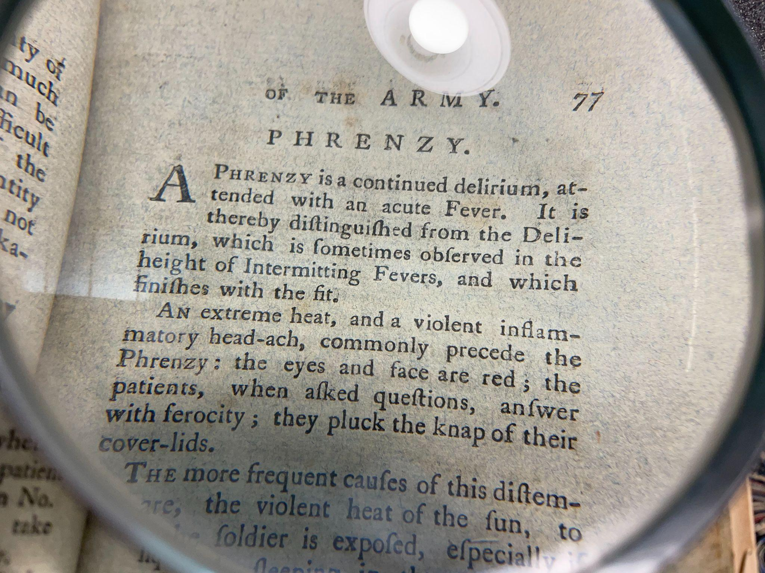
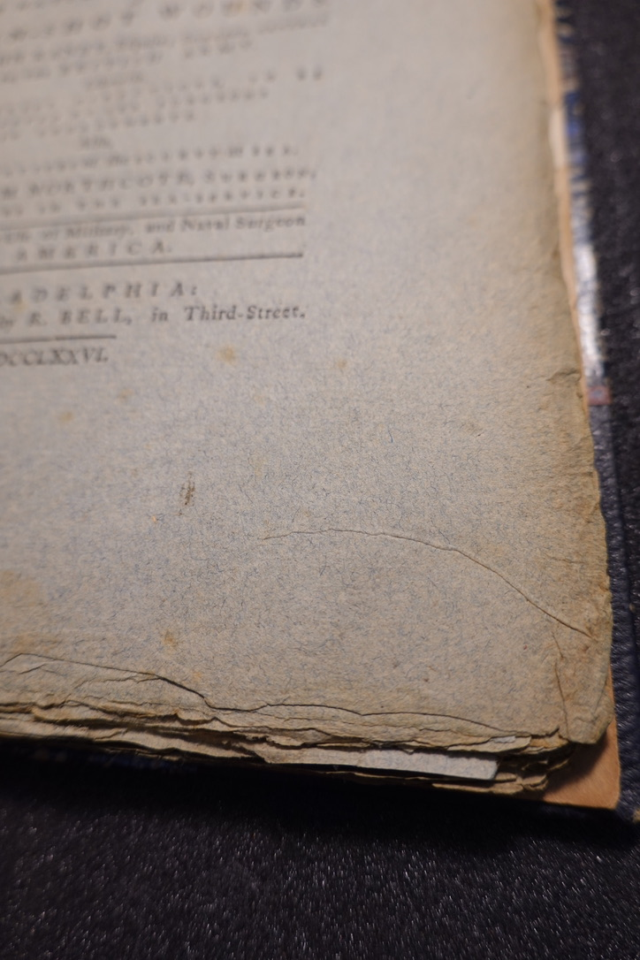
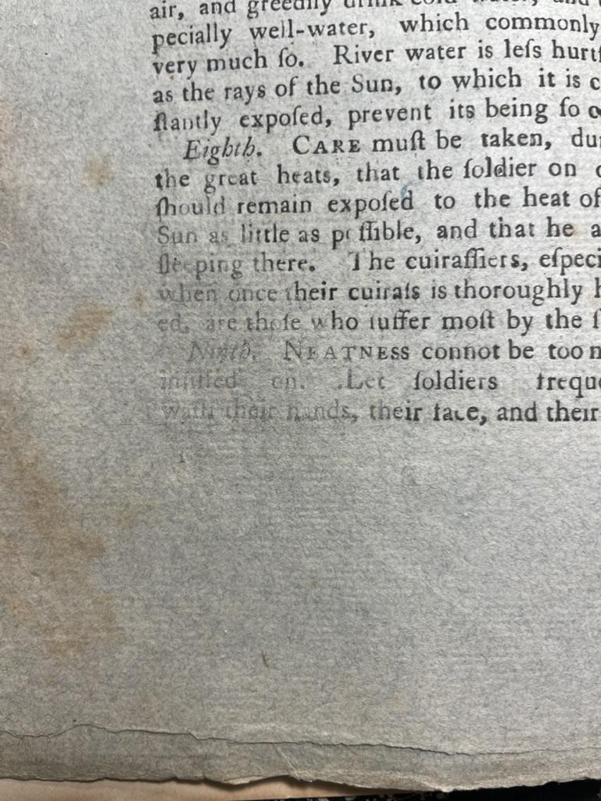
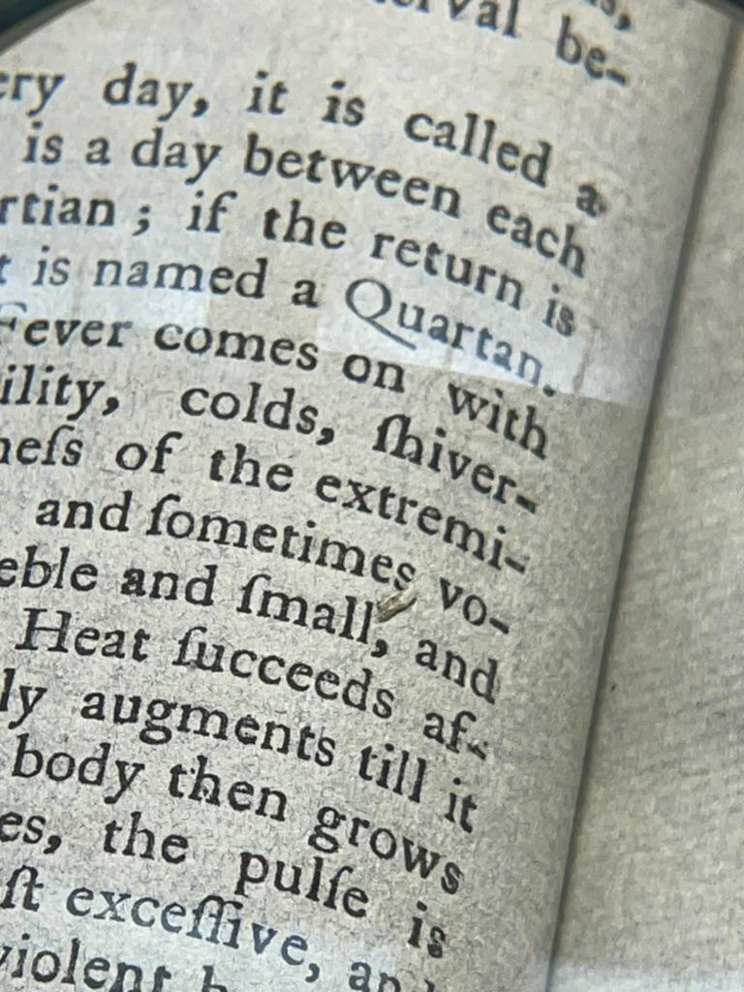
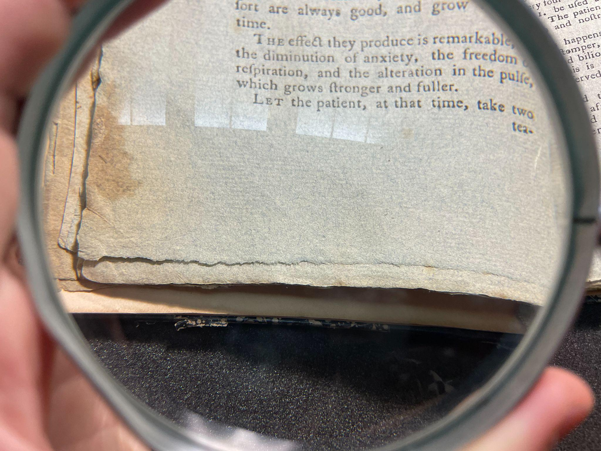
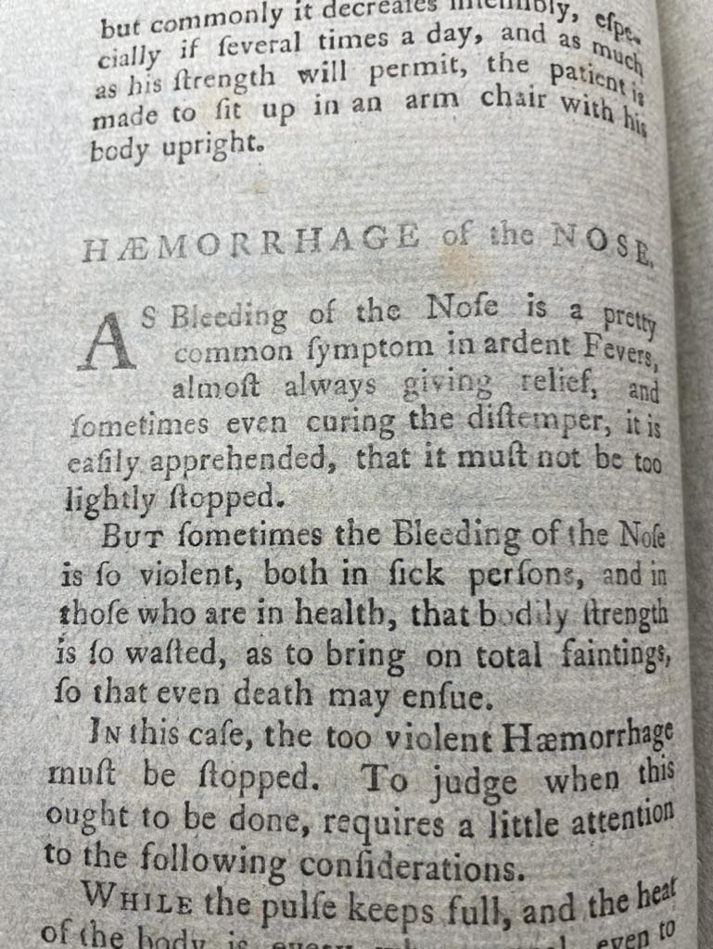
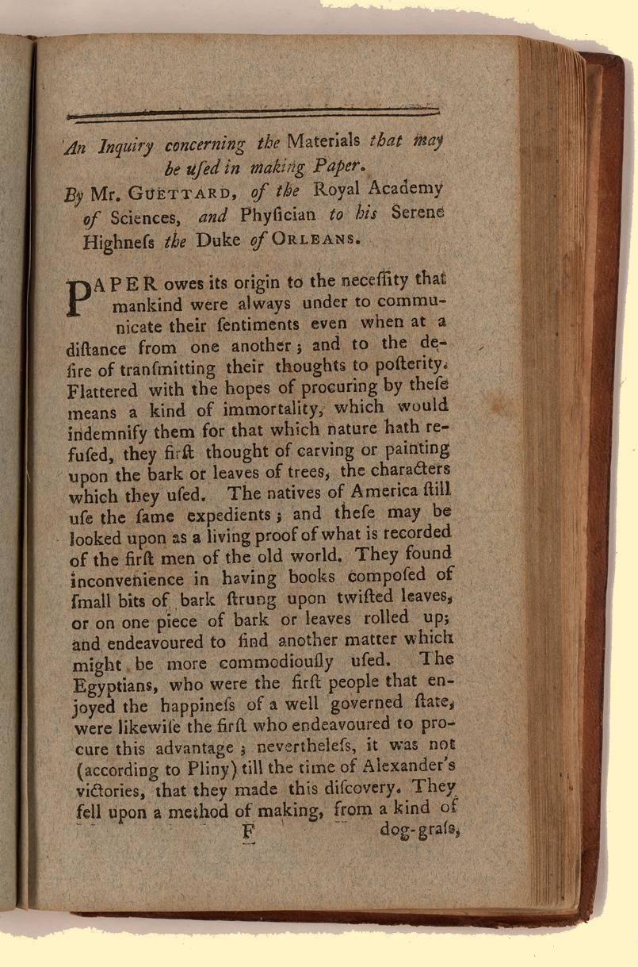
Paper
Revolution Blues
Notes:
Another important feature of this book is the paper, whose qualities are reflective of the colonial and specifically revolutionary-era papermaking industry. The paper is blue, due to its impurity and likely high wool content, as visible in the fibers here. Papermaking had a longstanding history in the colonies, but largely went underground in the revolutionary era as the Stamp Act and Townshend Act heavily taxed colonists on paper by requiring them to purchase imported British paper subject to exorbitant tariffs.
There are no watermarks on this paper due to these conditions under which it was produced, as many papermakers may not have wished to sign their work due to the illegal and politically risky nature of the work of papermaking at the time. This was common in paper at the time, though watermarks were used widely in American papermaking before and after the revolutionary period (and during!). Dard Hunter’s Papermaking in Pioneer America, general trends in these watermarks are described as follows:
“In early American papermaking the watermarks were in the form of fanning and household implements, tools, utensils, crests, arms, leaves, flowers, trees, doves, eagles, animals, human figures, and the names or initials of the papermakers. Two common watermarks in eighteenth- and earlynineteenth-century American paper are the phrases "SAVE RAGS" and "WORK AND BE RICH," the latter lettering usually in connection with the design of a plow.” (p 18)
Robert Bell, printer of this book, was heavily involved in the domestic paper industry, particularly in efforts to mobilize the masses to donate their rags for paper production by introducing a system of incentives, sponsored by printing industry heavyweights and advertised heavily in the newspapers they printed. In 1777, a year after publishing both Common Sense and The Diseases Incident to Armies, he published a book that contained the first text on papermaking to be printed in America, pictured here.
Note impurities in the paper, foxing, printing irregularities, and uneven deckled-type, brittle edges to the pages.

Slide 5
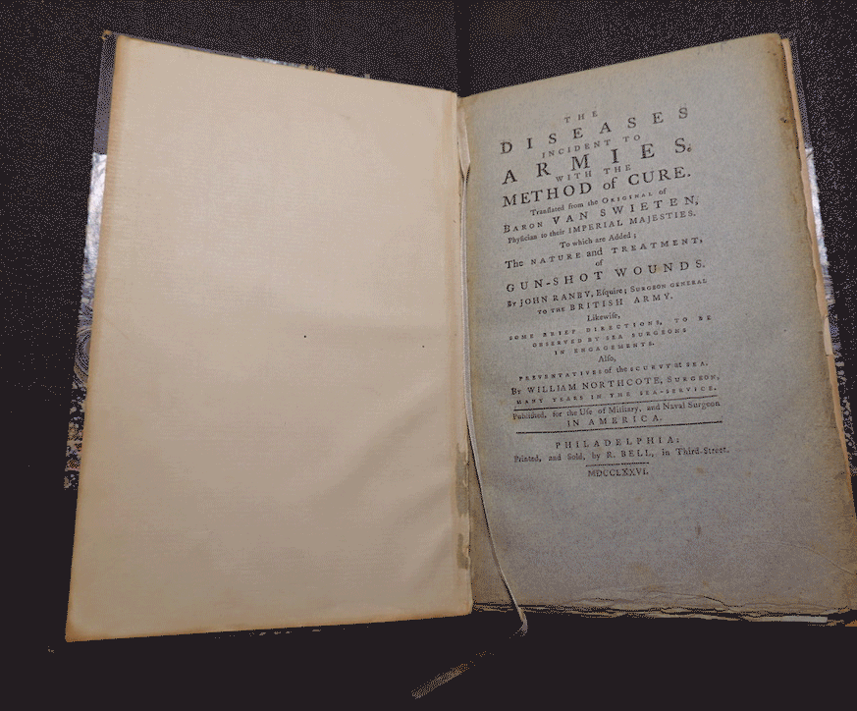
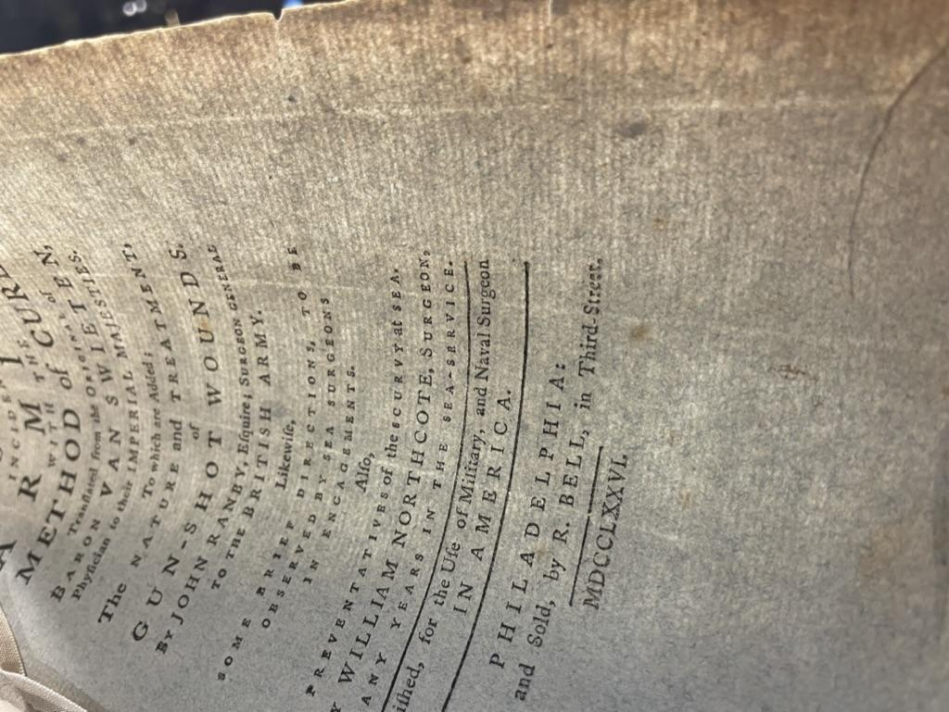
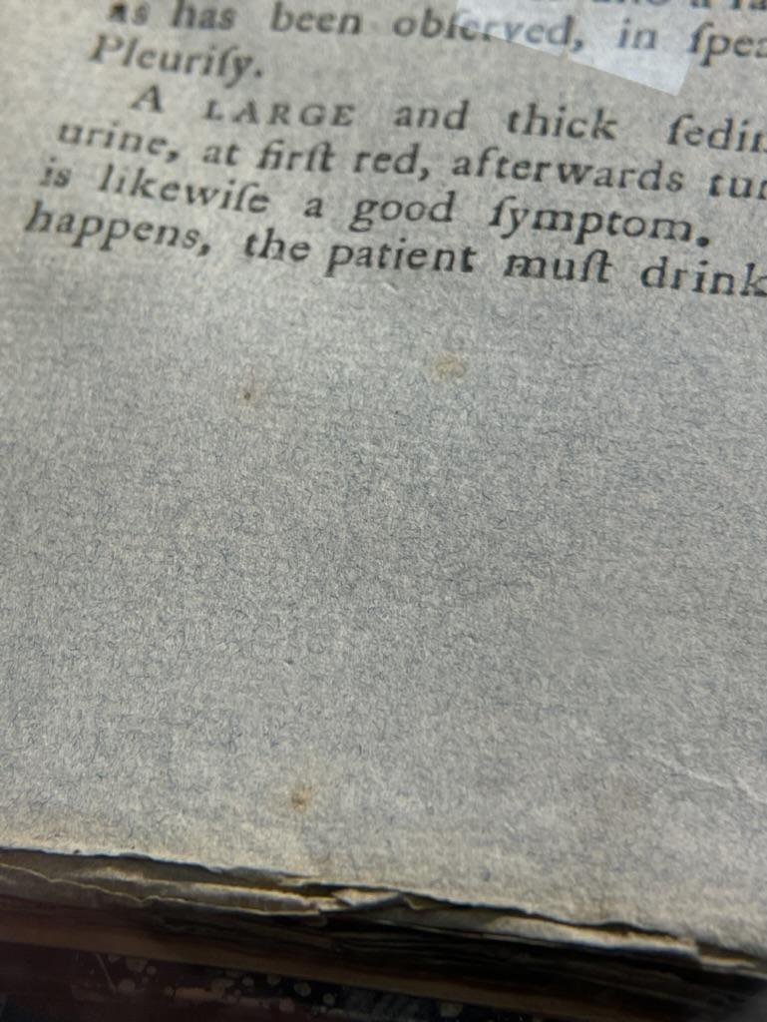
Formulary
8⁰:
[A]⁴ B² C-P⁴ ²P-U⁴ [W]²
[$1(-W¹) signed];
84 leaves,
pp. [1-5] 6-8 [9-13] 14-103 [104] 105-112 [113-117] 118-128 [129] 130-150 [151] 152-164 [165-168]

Slide 6
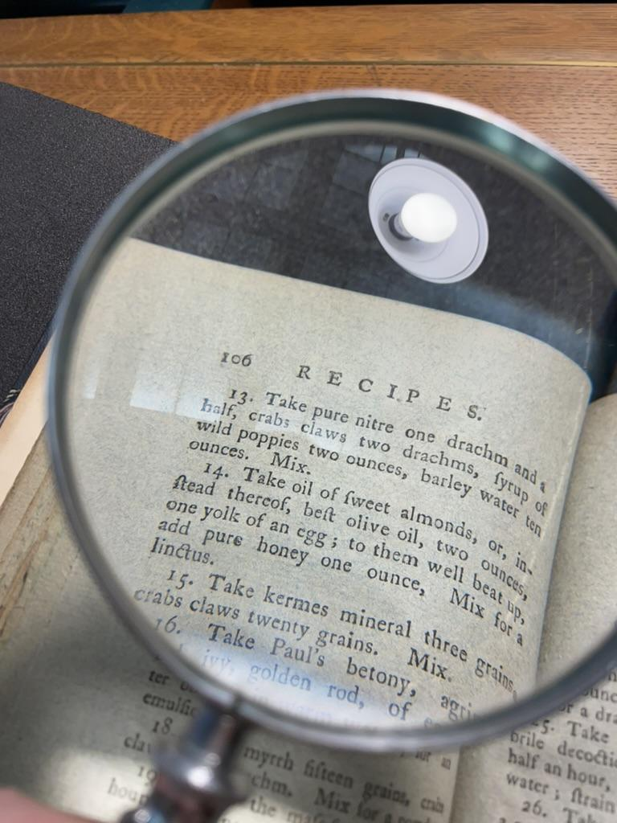
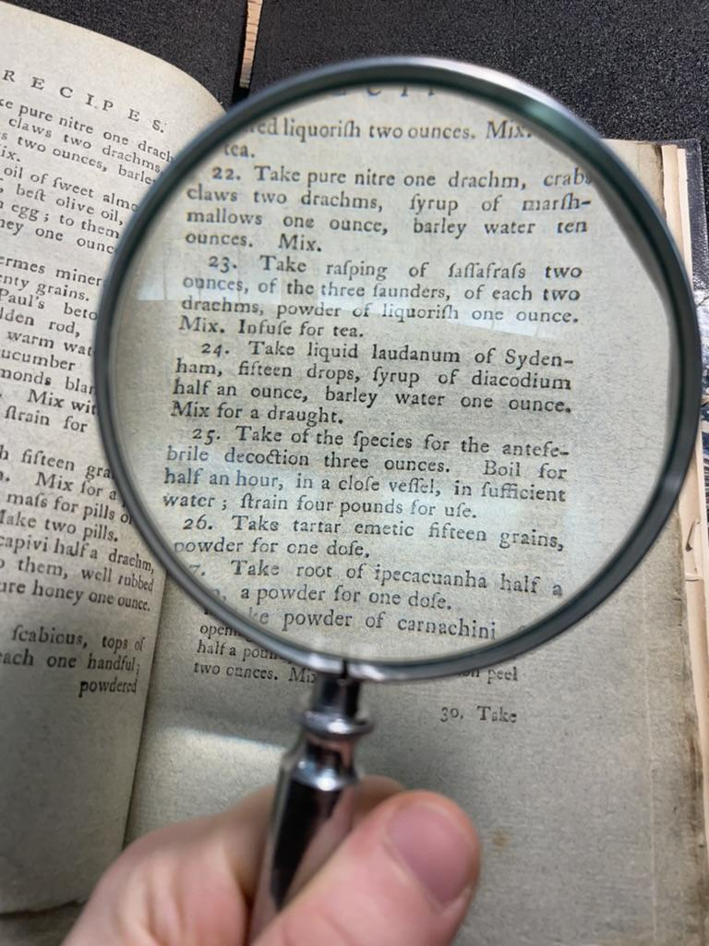
Questions? Painkillers?
ſources:
Bell, Robert. Robert Bell, bookseller, provedore to the sentimentalists and professor of book- auctioniering in America, is just arrived from Philadelphia; with a small collection of modern, instructive, and entertaining books, which he will exhibit by auctio. 1780. Pdf. Retrieved from the Library of Congress, www.loc.gov/item/2020768737/.
Bailyn, Bernard. The Press and the American Revolution. Northeastern University Press, 1984.
“Bibliography of Early American Publishers and Printers.” Wikipedia, Wikimedia Foundation, 25 Apr. 2024, en.wikipedia.org/wiki/Bibliography_of_early_American_publishers_and_printers.
Brückle, Irene. “Historical Manufacture and Use of Blue Paper.” The Book and Paper Group Annual, vol. 12, 1993, https://cool.culturalheritage.org/coolaic/sg/bpg/annual/v12/bp12-02.html.
Eldridge, Larry D. A Distant Heritage: The Growth of Free Speech in Early America. New York University Press, 1994.
Evans, Charles. American Bibliography: Volume 5: 1774-1778. Hollister Press, 1909.
Everton, Michael. “‘The Would-Be-Author and the Real Bookseller’: Thomas Paine and Eighteenth-Century Printing Ethics.” Early American Literature, vol. 40, no. 1, 2005, pp. 79–110. JSTOR, http://www.jstor.org/stable/25057382.
“Gerard van Swieten: ‘Vampyrismus’ – Attempted English Translation.” Vampire Film Reviews, 22 Dec. 2019, vampirefilmreviews.wordpress.com/blog/gerard-van-swieten-vampyrismus-attempted-translation/.
Hunter, Dard. Papermaking in Pioneer America. University of Pennsylvania Press, 1952.
“The Illustrated Colonial Printer: Materials.” The Illustrated Colonial Printer: A Website to Accompany The Colonial Printer by Lawrence C. Wroth, John Carter Brown Library, Jan. 2012, www.brown.edu/Facilities/John_Carter_Brown_Library/exhibitions/printer/pages/materials.html.
Landis, D B. “Robert Bell, printer.” Journal of the Lancaster County Historical Society, vol. 12, no. 5, 1908, p. [195]-202, https://collections.lancasterhistory.org/media/library/docs/vol12no5pp195_202_207825.pdf.
“Robert Bell (Publisher).” Wikipedia, Wikimedia Foundation, 10 Sept. 2023, en.wikipedia.org/wiki/Robert_Bell_(publisher).
Slauter, Eric. “Reading and Radicalization: Print, Politics, and the American Revolution.” Early American Studies, vol. 8, no. 1, 2010, pp. 5–40. JSTOR, http://www.jstor.org/stable/23546599.
"Swieten, Gerard Van ." Complete Dictionary of Scientific Biography. Encyclopedia.com. https://www.encyclopedia.com.
Wroth, Lawrence C. The Colonial Printer. Second edition, revised and enlarged ed., Dominion Books: A Division of University Press of Virginia, 1964.
Notes:
Questions? Painkillers? These are two images from the “RECIPES” section of van Swieten’s text, including a recipe for opium with crab claws(?) and a “draught” made basically of morphine mixed with morphine.
And here are my sources!

